Slide 1

Topic: Robust Aggregation for Federated Learning
Minor Project : ELD780
Supervisor: Prof. Harshan Jagadeesh
Name:- Animesh Lohar Entry No:- 2024EET2368
M.Tech in Computer Technology

Slide 2
Outline:-
Introduction
The Problem
Robust Aggregation Approach
Experiments
Conclusion

Slide 3
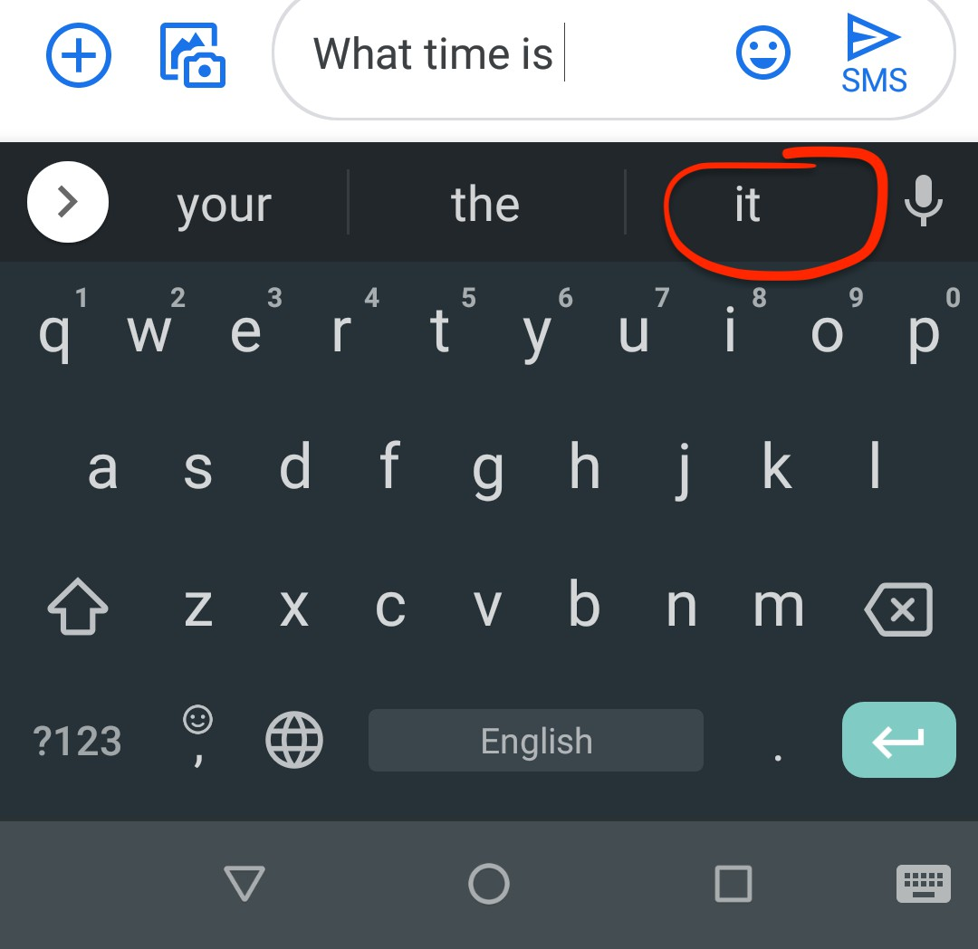
Introduction:-
Distributed training ML models on decentralized data on, e.g., mobile phones
Examples: next word prediction
Privacy restrictions:
My data does not leave my phone
Secure aggregation: Server can only see my model parameters after aggregation with several other users
Users are heterogeneous

Slide 4


Federated Learning:-
1. Broadcast
Server
2. Local update
Server
3. Secure Aggregation
Server
+
Sec.Avg.
devices
selected

Slide 5





Federated Learning:-
Secure Aggregation
Server
weighted arithmetic average!
+
selected
devices
corrupt.
corrupt.
Since the arithmetic mean is not robust to outliers, federated learning is susceptible
to adversarial devices.
July 29, 2020
5 / 52

Slide 6
The Problem Statement:-
Aggregation procedure for FL is
Robust to corrupted updates sent by client devices.
Privacy-Preserving
Practically, aggregation requires
Communication-efficient.
Practical: minimal engineering overhead relative to existing systems

Slide 7



Secure Average Oracle:-
m
Computes weighted arithmetic average Σ
The device k’s vector w_{k} is not to any other device or the server
α_{k}w_{k} s.t.
k=1
Secure Average Oracle
Server
_{k} α_{k}w_{k}
Typically implemented using cryptographic protocols
selected
devices
w1
w2
w3
w4
w5
Modified Goal: The Aggregation procedure for FL is
Robust to corrupted updates sent by client devices.
Can be implemented using a small number of calls to a Secure Average Oracle
July 29, 2020
8 / 52

Slide 8
Corruption Model
Allowed corruption types and the capability of the adversary
Corruption Type | Data write | Model read | Model write | Aggregation | Allowed?
Non-adversarial | - | - | - | - | ✓
Static data poisoning | Yes | - | - | - | ✓
Adaptive data poisoning | Yes | Yes | - | - | ✓
Update poisoning | Yes | Yes | Yes | - | ✓
Byzantine | Yes | Yes | Yes | Yes | N/A
Byzantine robustness is not compatible with secure average oracle.

Slide 9

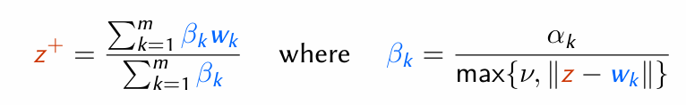
Robust Aggregation using the Geometric Median:-
Geometric median (GM) of w₁, … , w_{m} ∈ R^{d} with weights α₁, …. , α_{m} > 0 is defined as the minimizer of :
m
g(z)
Σ
α
||
z - w
||
:=
GM
AM
Outlier
k
k
k=1
The smoothed Weiszfeld algorithm [Weiszfeld, 1937]:
Each iteration is implemented with 1 call to secure the average oracle.

Slide 10
Data Visualization:-
Visualization of β_{k}/α_{k} :
EMNIST Linear, = 10 ², Data
Shakespeare LSTM,
= 1/4, Data
corrupted
not corrupted
1.3
1.8
Weight ratio
Weight ratio
1
1
0.28
0.61
0 20 40 60 80 100
Device id.
0
5
10
15
20
25
30
Device id.
Department of Electrical Engineering
16 / 52

Slide 11
Conclusion:-
Robust aggregation for FL based on geometric median.
Constant times the communication cost of FedAvg.
Similar performance in low corruption regime, more robust in high corruption regime.
Applicable in a wide range of settings.
Regarding theoretical results:
The same technique works for general convex losses in the i.i.d. case
Proof does not work for non-i.i.d. setting
Experiments on naturally non-i.i.d. real-world data show robustness of RFA
Backdoor attacks:
Goal here is not to degrade the global model on the main task (whose quality is measured by the loss)

Slide 12
References:-
Paper:
https://arxiv.org/abs/1912.13445
Implementation of RFA on TensorFlow Federated: https://github.com/tensorflow/federated/tree/master/tensorflow_ federated/python/research/robust_aggregation
Alistarh, D., Allen-Zhu, Z., and Li, J. (2018). Byzantine Stochastic Gradient Descent.
In Advances in Neural Information Processing Systems 31, pages 4618–4628.

Slide 13
Thank You

